Slide 1

Battle of neighborhood
Business analytics

Slide 2
Case : locate an ideal location for Korean restaurant Client : heung-min-son

Slide 3
Problem statement
Heung-min-son interest to open a brand new restaurant in Toronto Canada
Location play significant role in success of restaurant business
Assumed that the location concentrate with restaurant is a prime location because there are constant crowd walking the area
In this project we will search for a place with no or least concentrate Korean restaurant

Slide 4
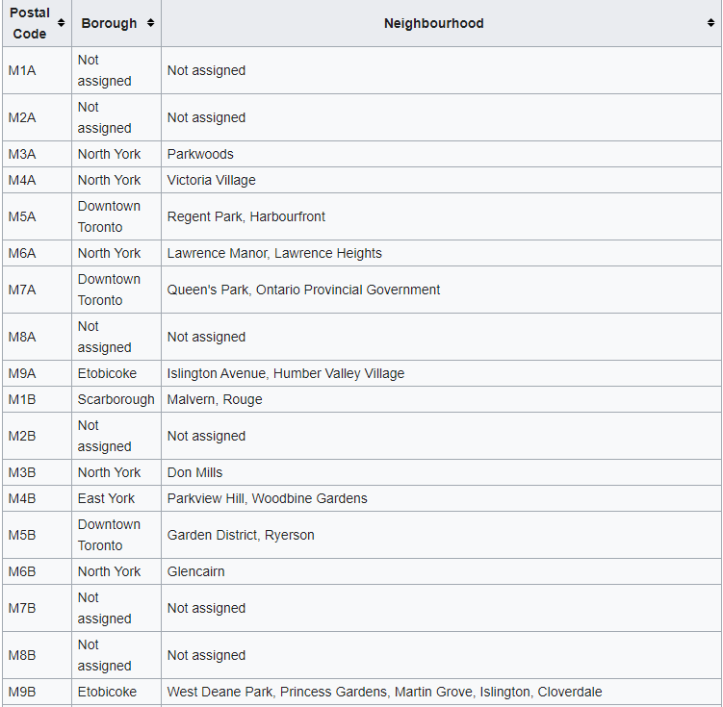
Data acquisition
From the postal code and neighborhood of Toronto are scraped from Wikipedia
Link : https://en.wikipedia.org/wiki/List_of_postal_codes_of_Canada:_M
Restaurant data is extracted via foursquareapi

Slide 5
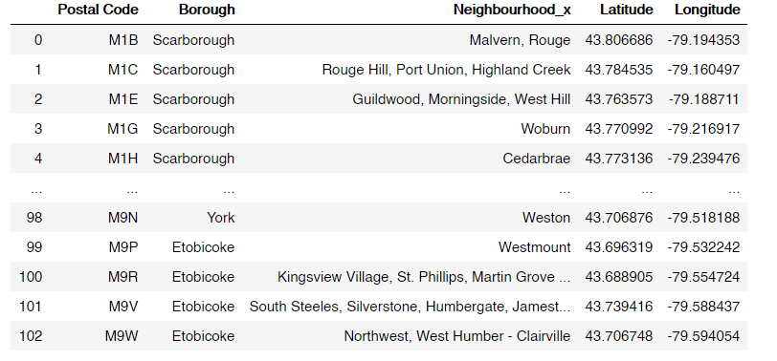
Data cleaning
the scraped data was first cleaned. Empty value cells and cell with the value “not assigned” were dropped. The dataframe was merged with the dataframe of geospatial data. With that the co-ordinates were assigned to every neighborhood. The cell having borough names and neighborhoods names were allotted borough names under the neighborhood column.

Slide 6
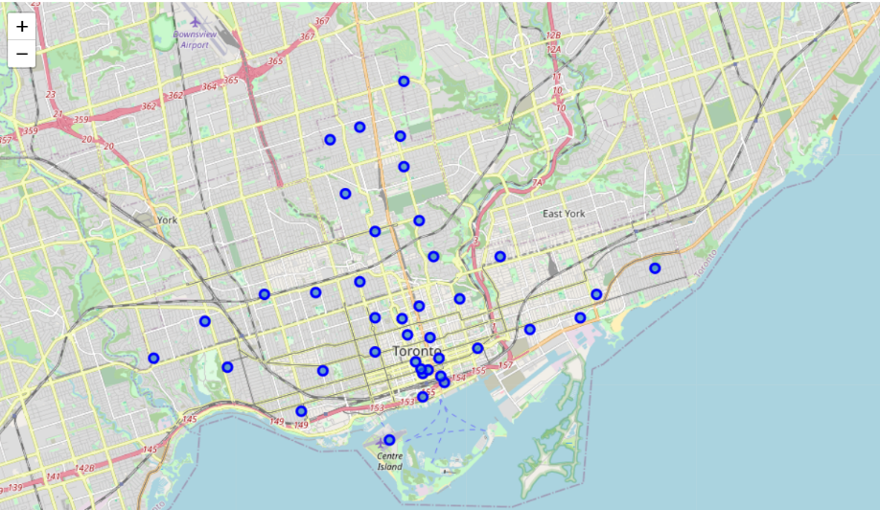
Methodology
3.1 Feature selection
Since our primary focus area is the restaurant. We filtered out the data returned by Foursquare API to include the venue category having the term “ restaurant”. Thus the data which were not required (historical monument, bakery, cafe etc.) were dropped from the dataset
3.2 Exploratory data analysis
3.2.2 Plotting of neighborhoods on a map

Slide 7
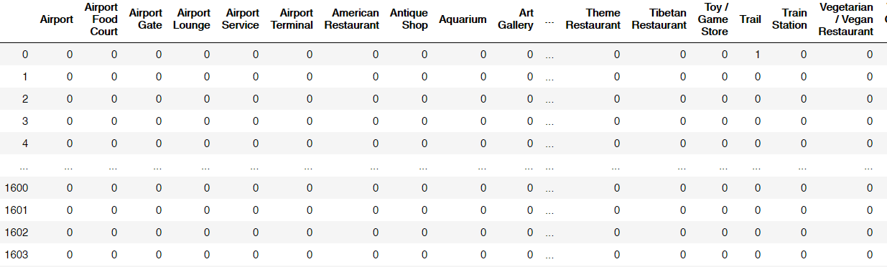
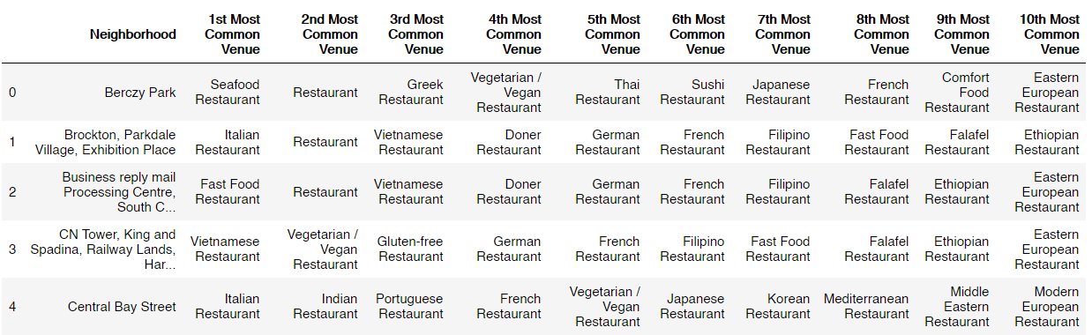
Methodology
3.2.3 Onehot encoding
Onehot encoding was carried out on the data to create dummy variables for the venue category as it is a categorical variable
3.2.3 create the most common venue base on restaurant category

Slide 8
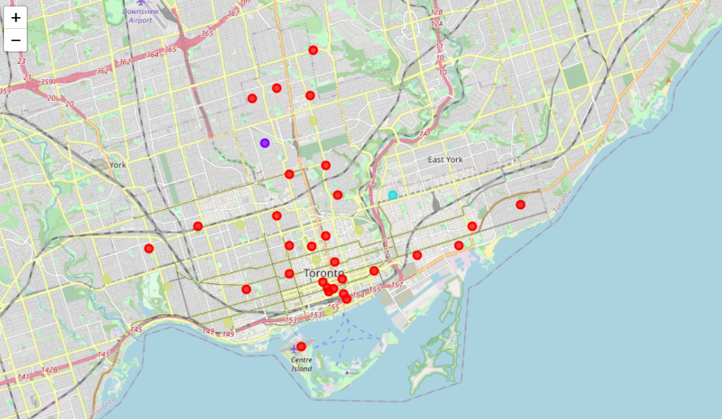
Classification using Kmeans clusterings
the restaurant were classified using KMeans clusterings. They were cluster based on their density. There will be 5 cluster

Slide 9
Analyzing the result
Our most suit location contains 3 criteria
1 high density of restaurant number
2 low density of Korean restaurant number
3.high density of similar cuisine such as Japanese, thai , etc.

Slide 10
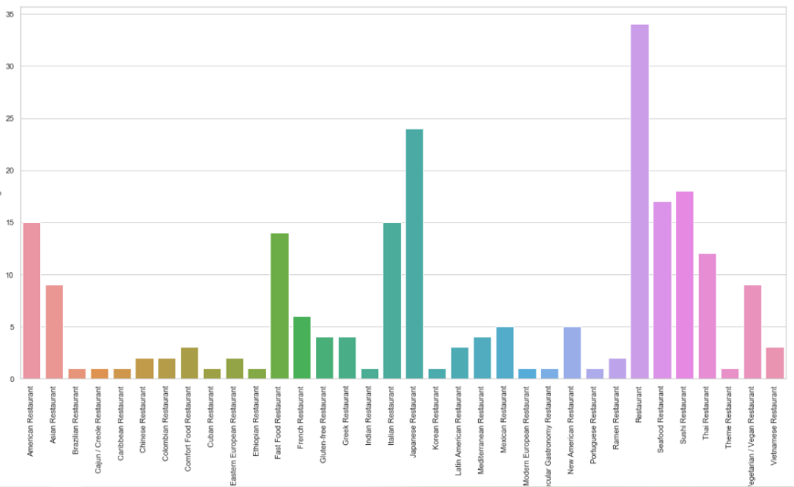
Cluster 0

Slide 11
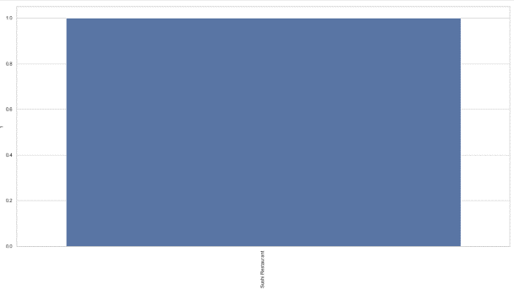
Cluster 1

Slide 12
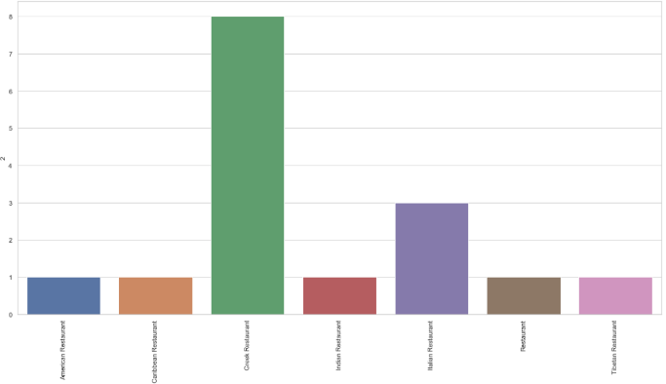
Cluster 2

Slide 13
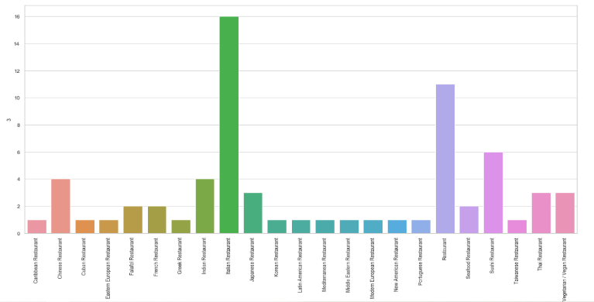
Cluster 3

Slide 14
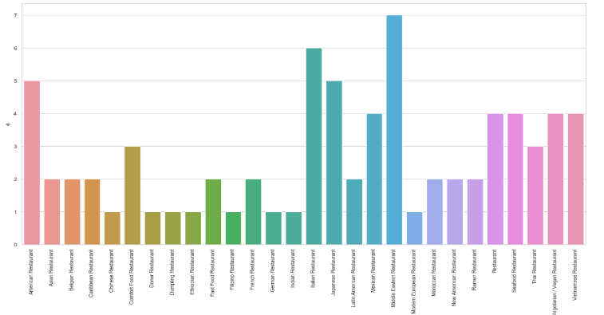
Cluster 4

Slide 15
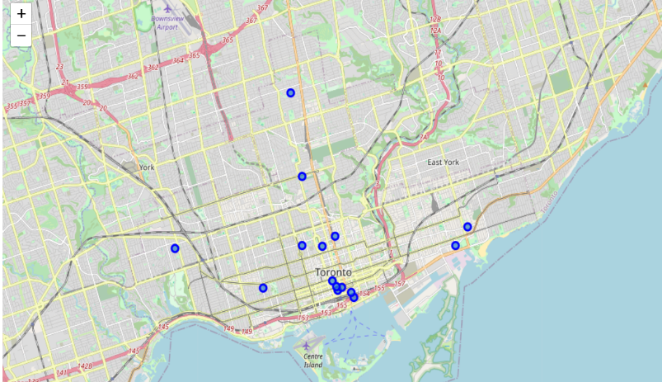
Conclusion
As shown in the report the most suit cluster for Korean restaurant based on given criteria is cluster 0 because it contains total of 235 restaurants with 25 of Japanese restaurants and only 1 korean restaurant. In the area shown below is the best location for open Korean restaurant

